Slide 1

Lecture 1
Getting Started
Matthew Valentine
Office: Tech Room Lab K2
mvalentine@uwc.ac.za

Slide 2

Learning objectives
To be able to use the SAS Software program in a windows Environment
To understand basic information about getting data into SAS and running a SAS Program
To be able to run a simple SAS program

Slide 3
Why SAS®?
SAS system is a powerful software program designed to give researchers a wide variety of both data management and data analysis capabilities.
The two main concepts in learning SAS are the following;
How to get data into SAS and ready for analysis.
How to perform the desired data analysis.
Employment
Most companies in todays 4th industrial revolution require you to have coding skill in the following namely; (SAS®, R, Python, SQL and Excel VBA)
SAS is one of the leading analytical software suppliers to

Slide 4
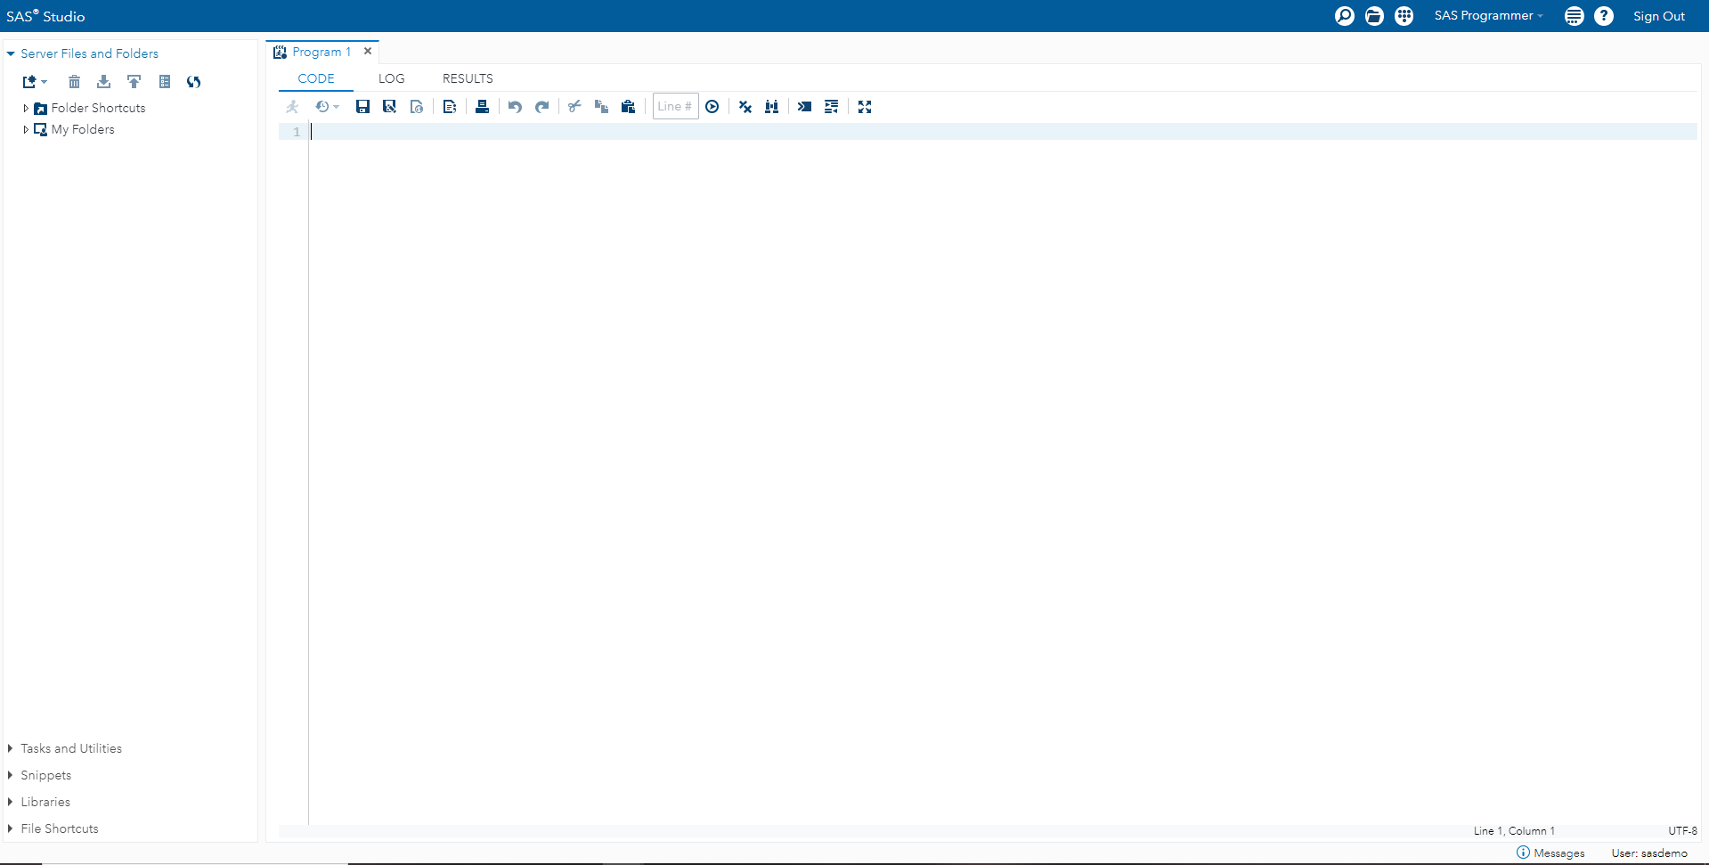
Using SAS in a Windows Environment
SAS runs on many other operating systems such as; UNIX, MAC OS x, Linux and Windows.
The book we will be using is based on Windows Environment.

Slide 5
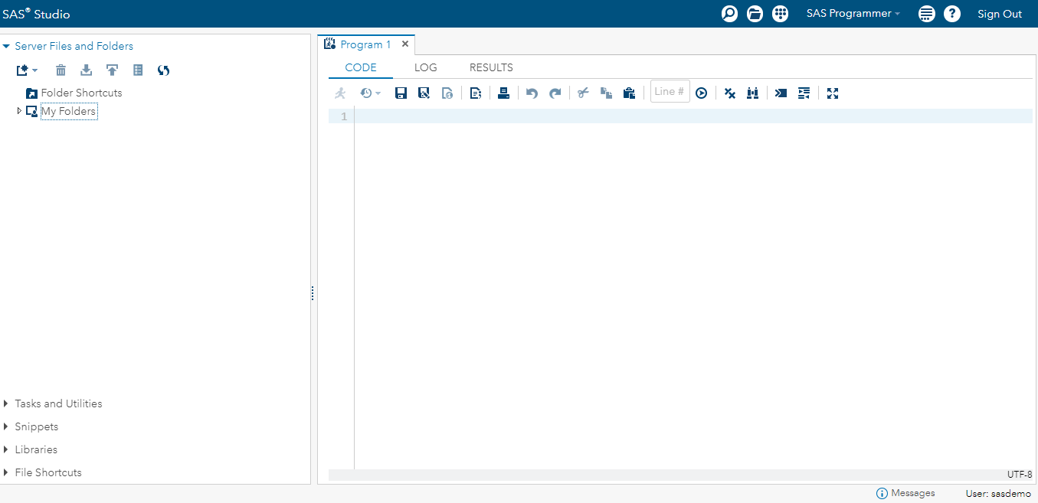
Using and understanding SAS in a windows Environment
SAS Studio (University Edition)
Editor Window
Log Window
The output window will appear once you run SAS program code within the Editor.
SAS Explorer/ Results Window
Tab for Output Window

Slide 6
Using and understanding SAS in a windows Environment
The purposes of these windows:
Editor: “Enhanced Editor Window”. This is the area in which SAS code will be written. SAS code is stored in a text called “American Standard Code for Information Interchange” – ASCII. This means that previously written code can be saved in any word processor and pasted in SAS’s Editor Window with ease.
Log: After you have ran a SAS Program, a detailed explanation of the program will be shown in the Log Window. The Log Window is also a handy tool to understand what SAS Program code Errors you have made. The Log Window also contains, warning and Notes about the SAS Program code you have ran. Typically, the errors will be highlighted in red.
SAS Explorer/Results: This Window is shown on the left of the screen and contains to Tabs. The results window shows all you SAS Program code that you have run in a tree-like fashion. The Explorer tab indicates the available libraries as well as shows which SAS data files are kept.
Output: Once you have ran your SAS Program Code in order to perform your analysis. The Output Window displays all your results pertaining to the Code that you have ran.
Graph: When SAS Program Code has been run, and the set Analysis has indicated the needs for graphs. It will be displayed, usually be default.

Slide 7
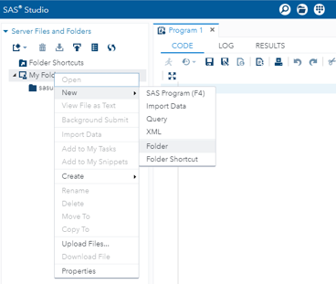
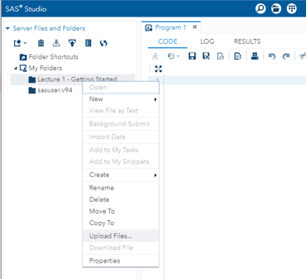
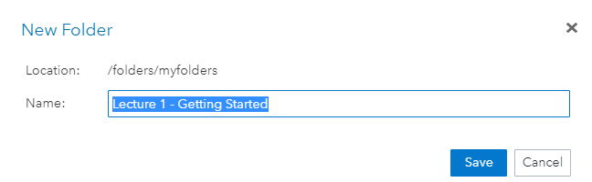
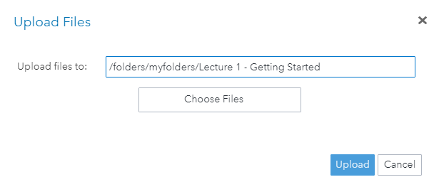
Using SAS in a Windows Environment
To create a folder to store our SAS Program Data, the following will be done; Click on “My Folders” - > “New” - > “Folder” - > “Name” – “Chapter 1 – Getting Started” -> “Save”
To Upload the SAS Program Data, the following will be done; Click on “Lecture 1 – Getting Started” -> “Upload Files” -> “Choose Files” -> “Upload”
1
3
2
4

Slide 8
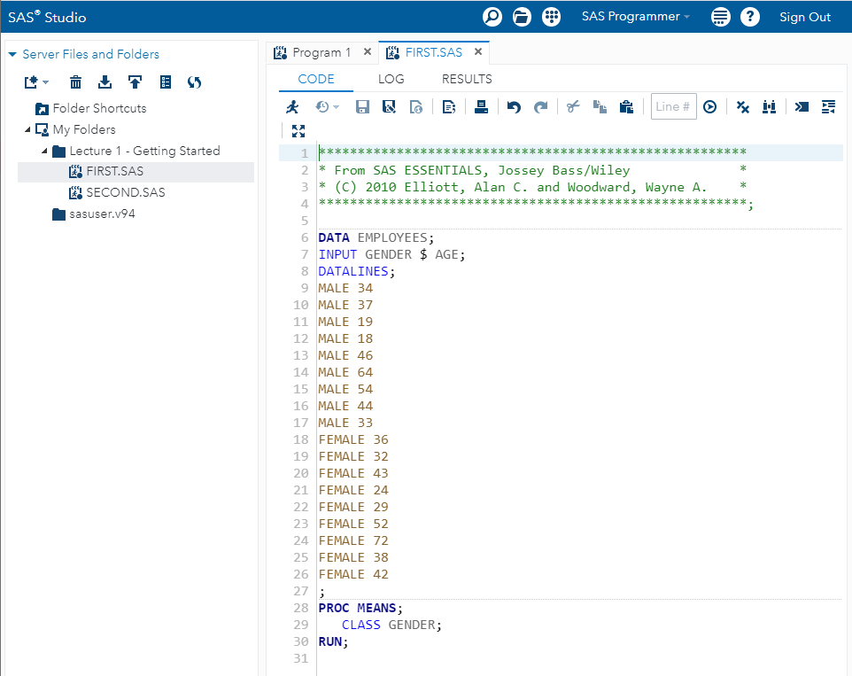
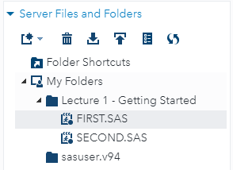
Your First SAS Analysis
Open the Program file. The example uses the file name FIRST.SAS. In order to open the file you have to do the following;
Double click on the FIRST.SAS Program file.

Slide 9
SAS Enhanced Editor Window Colour Coding
Enhanced SAS Editor Window: When writing any SAS Program, the code will display text in various colours. For instance;
Green: Is used for comments
Red: Indicates Error in Code
Dark Blue: Is used for the Keyword in major SAS Commands
Yellow: Is used for data (In SAS Studio (University Edition) it will not be highlighted in Yellow.
Boundary Line: This separates each step

Slide 10

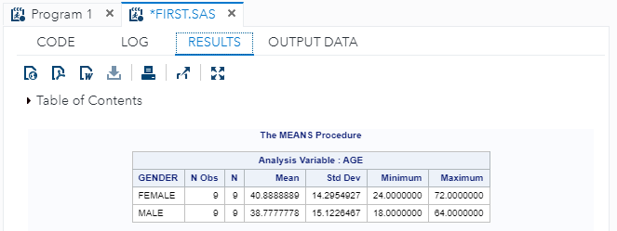
Your First SAS Analysis
Run the SAS job. On the Menu Bar ->, select Run or clicking on the Symbol.
View the Results tab. If the job runs without any errors, the output window will displayed indicating the analysis output created by the program.
Example: In the editor window, open the file FIRST.SAS

Slide 11
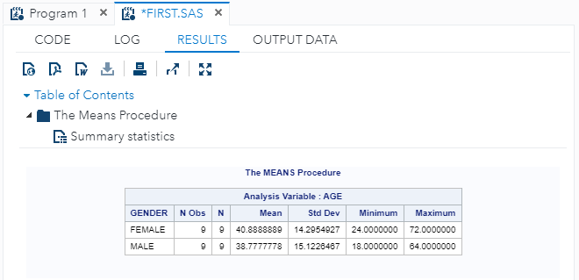
Your First SAS Analysis
In the results window, one is also able to view all the results that was run by the SAS Program. This can be found by using the drop down (Table of contents)
This will show you what your results you have produced using the PROC MEAN procedure.

Slide 12
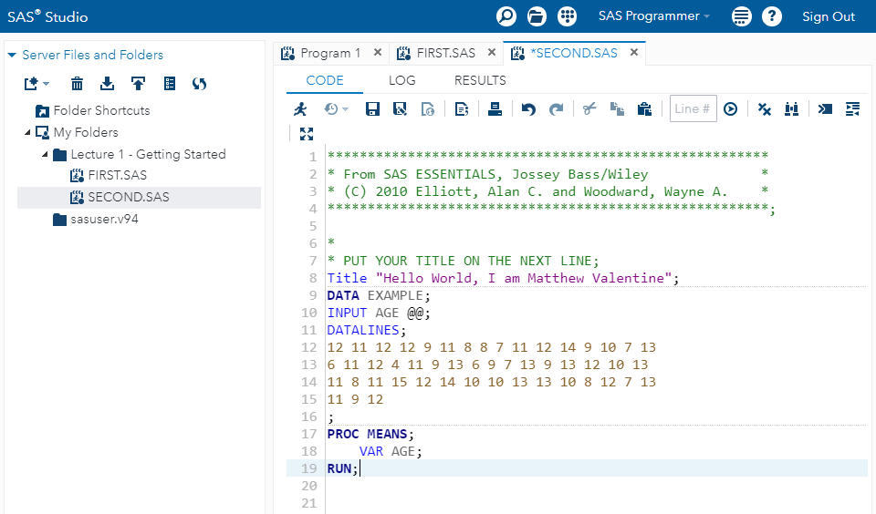
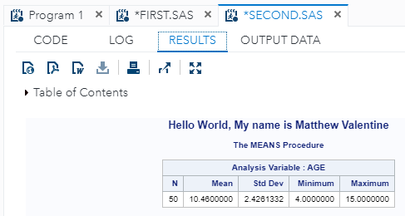
Your First SAS Analysis
Follow the instructions on Slide 7: the import the dataset.
We will make a small change in the program and see how that change alters the output. We will be using the Option “TITLE”.
The Output above will be produced.
Example: In the editor window, open the file SECOND.SAS

Slide 13
How does SAS work?
Three basic steps about how SAS works
Data step: Enter the data into SAS
PROC/ Procedures: Tells SAS what analysis to perform
Output Step: Observing the output and informs SAS where to output that data to.

Slide 14
Tips and Tricks for running SAS Program
One statement can continue over several lines
Several statements may be on the same line
You may have blank spaces between code, but at least one.
SAS is not case-sensitive
The most common error in SAS Programing is a misplaced (Or missing) semi-colon [;].
The second most common error in SAS Programming is a missing Run Statement.
A third common error is the presence of unmatched quotation marks.

Slide 15
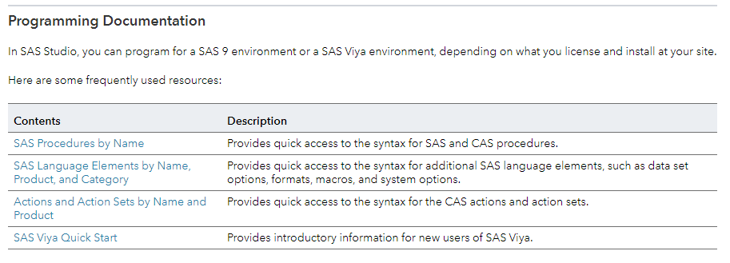
Getting Help From SAS
SAS help is available from the SAS help pull-down menu.
By clicking on the -> -> then selecting the topic SAS Studio Help. It will open up a new browser window. Lastly, scroll down to topic named Programming Documentation and select SAS Procedures by name, if you need help understanding the function of different procedures in SAS

Slide 16
Study
Chapter 1
Matthew Valentine
Office: Tech Room Lab K2
Mvalentine@uwc.ac.za

